Slide 2
OUR GUIDING PHILOSOPHY

Slide 3
Centres @ Jamui & Banka A joint initiative of Sankalp A Pledge to Change & Pahal Ek Nayi Soch

Slide 4
In the land of Buddha On the path to enlightenment.....

Slide 5
When Sankalp’s Pledge met Pahal’s Soch
Sankalp-A Pledge to Change in association with Pahal-Ek Nayi Soch started its mission education programme in the most backward blocks of Bihar
Jamui & Banka- two most backward districts in Bihar were chosen as the target areas due to low literacy levels amongst the children
Though most of the children are enrolled in different government schools, the educational & academic level is far from satisfactory which triggered thoughts to spread our wings in such areas for such children
A total of 110 children are currently enrolled at the two centres and are provided free of cost tuition to enhance their learning skills

Slide 6
TOGETHER WE COME...FOR A CAUSE

Slide 7
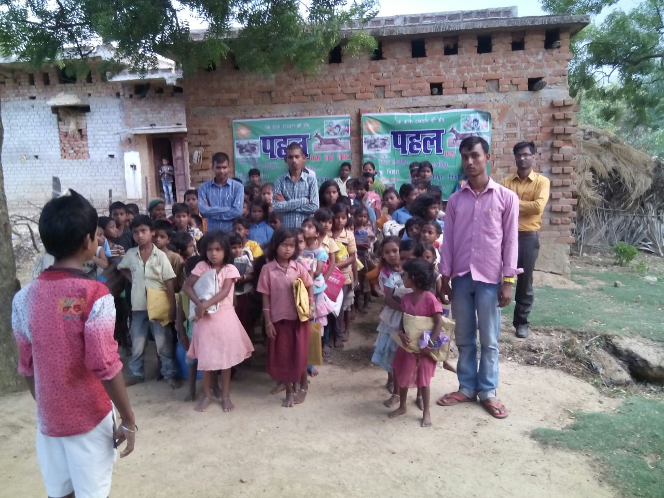
DOTS IN THE HINTERLAND

Slide 9
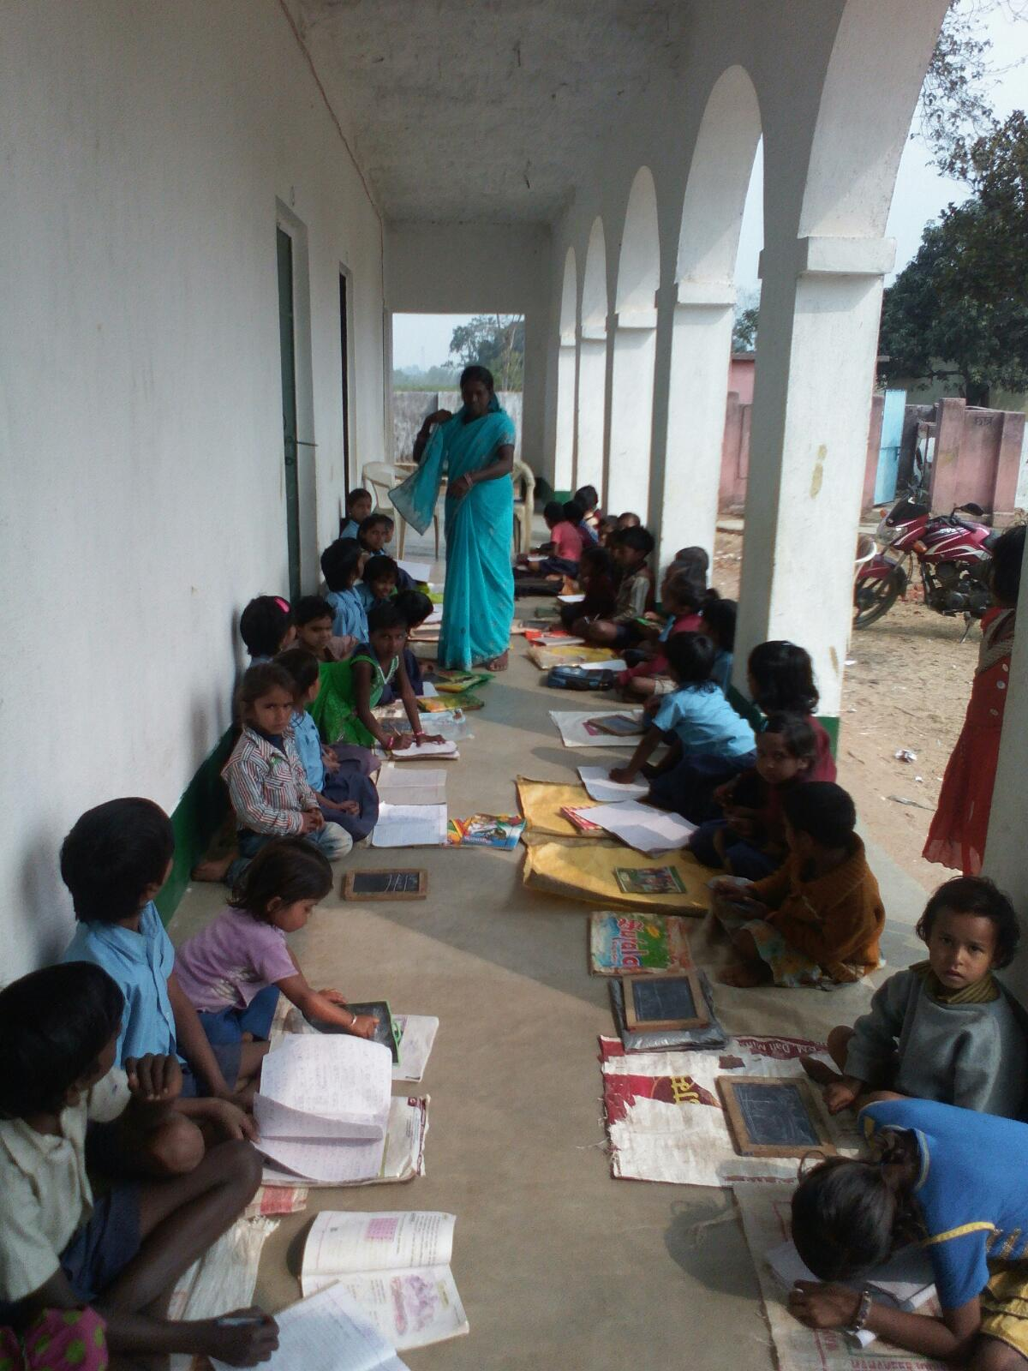
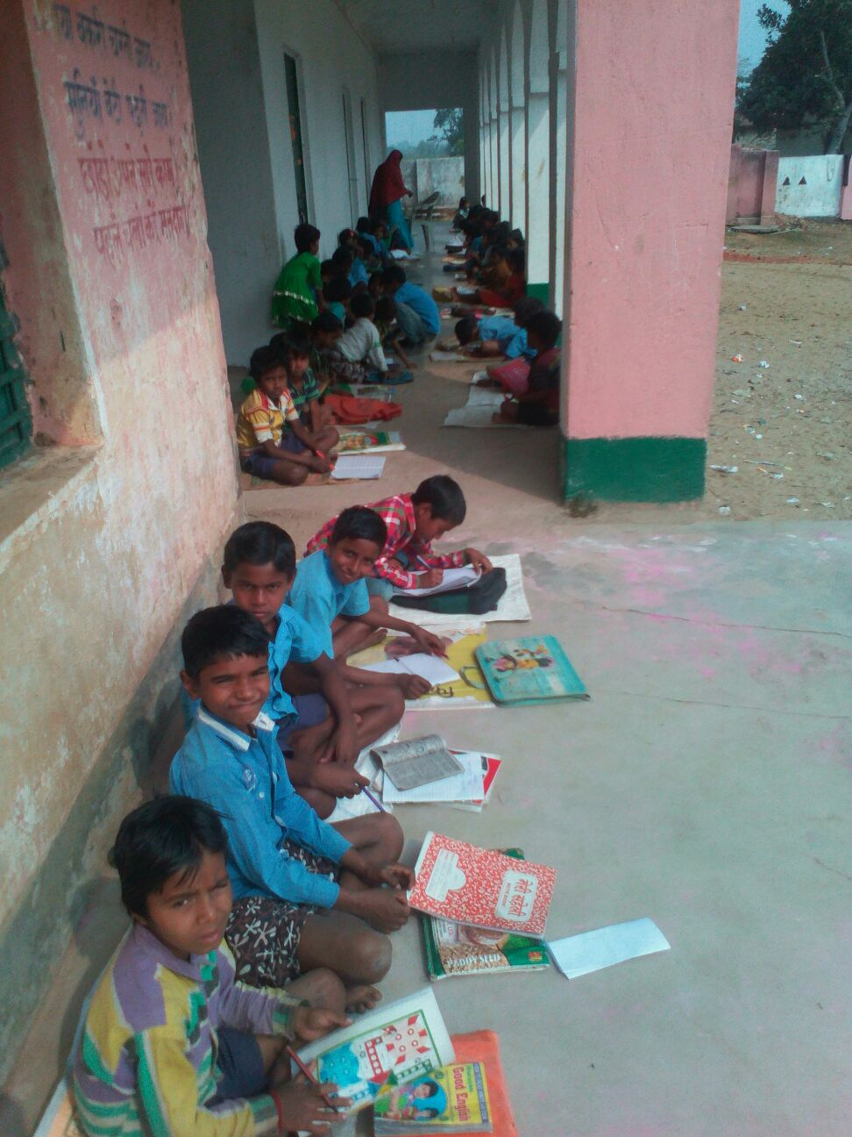
OUR FUTURE...OUR HOPE

Slide 10
When efforts manifest into fruits
Sankalp and Pahal’s
Inaugural Classes
@
Jamui & Banka

Slide 11
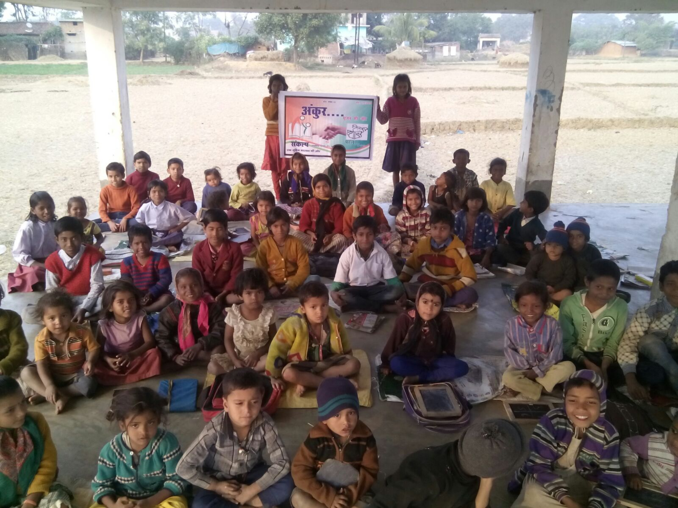
Ankur-Srijan Ki Oar Our Mission education Campaign Opening Classes

Slide 12
Inaugural Classes @ Banka

Slide 13
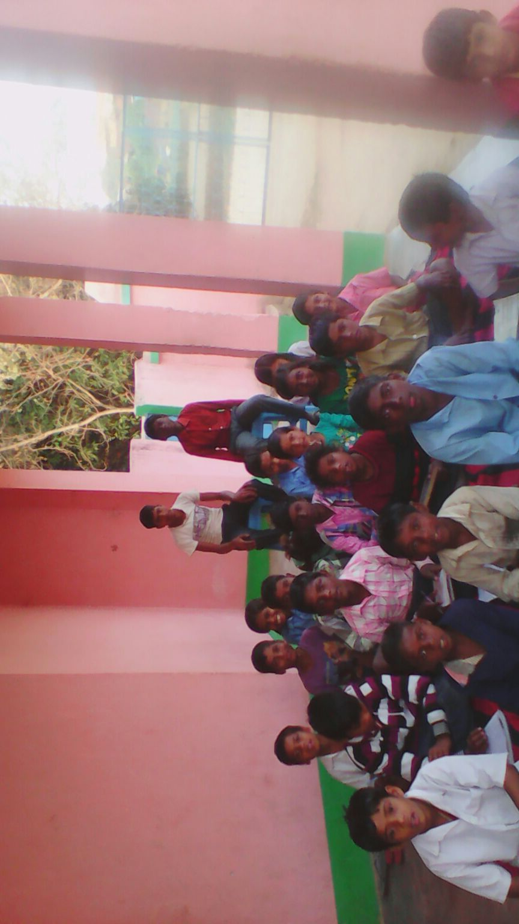
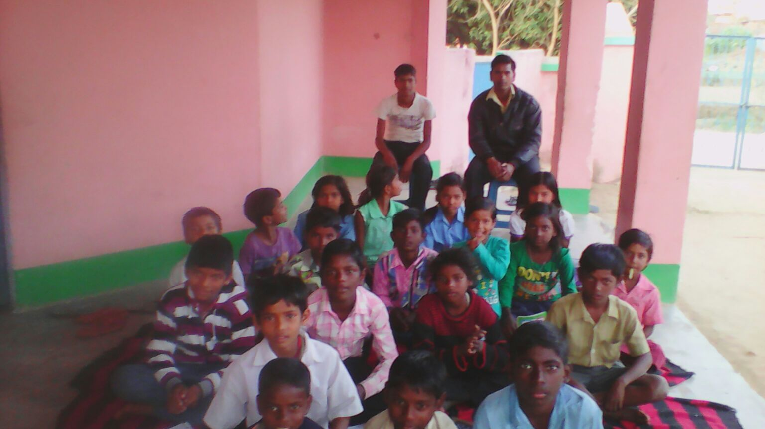
Inaugural Classes @ Jamui
Sankalp Team is sponsoring the complete Infra related expenditure and Teacher’s salary at both the centres

Slide 15
"Change will not come if we wait for some other person or some other time. We are the ones we've been waiting for. We are the change that we seek.“

Slide 16
COME BE A PART OF THE JOURNEY
You can donate at any our centres by just making a call to Sankalp-A Pledge to Change volunteers.
All our centres run 6 days a week
You may donate books from
Class 1-8- Course Text Books (Any Board)
Story Books
Unused stationery
Any other items like bag, toys, uniforms etc.
Relevant Contact Nos. Are
Subodh Kumar Das-9798756336
Mayank Aggarwal -9031975746
Suresh Pareek -7209632032
Vikas Dixit -9472706225

Slide 17
ACCOUNT DETAILS FOR SUPPORT
Sankalp Account Details
You can transfer funds online into our account:-
“SANKALP” A/C No.-31114719936
CIF No: 85757412911
IFSC Code: SBIN0001882
MICR Code: 831002004
Branch code: (1882)
Branch: SBI- RIT JAMSHEDPUR
You may also visit our website and pay through online link available over it.
www.sankalpnitjamshedpur.org

Slide 18
“You have not lived today until you have done something for someone who can never repay you.”
www.sankalpnitjamshedpur.org

